Slide 1
Banking 2024
dr. Mikolasek András
andras.mikolasek2@uni-corvinus.hu

Slide 2
Topics for discussion:
Banks in DSGE models
Data Science in assessing the credit quality of clients
Future of CBDC
What is new in Basel IV?
Transmission channels in Hungary
Shadow banking

Slide 3
Suggested readings:
Hans Keiding: Economics of Banking
Freixas-Rochet: Microeconomics of Banking
David Romer: Advanced Macroeconomics 5th edition
Chapter 10: Financial Markets and Financial Crises
Moorad Choudhry: The Principles of Banking
Bankmenedzsment – Banküzemtan; Editors: Kovács Levente – Marsi Erika
Carol Coye Benson: Global Payments and the Fintech Innovations Changing the Industry
Naeem Siddiqi: Credit Risk Scorecards
Móra Mária: 10 évvel a válság után
*Claudio Borio: Back to the future: intellectual changes for monetary policy

Slide 4
Crises history
01.01.1987. : Two-level banking system in Hungary begins
Early ’90s: Real estate market based credit crisis in Scandinavia and Japan
1992 Black Wednesday: English pound drops from ERM
Credit-consolidation programs in Hungary
Second half of ’90s:
Peso crisis in Mexico (1995)
Crisis in South-East Asia (Thailand, South-Korea, Malaysia, Indonesia) (1997)
Rubel crisis in Russia (1998)
End of currency-band speculation in Hungary
Crisis in Argentina (2001)
End of BUX speculation
2006 Collapse of ware receipts financing in Hungary
2007-2009: Global financial crisis
Collapse and settlement of currency-based loans in Hungary
2010-2012: Crisis in EUR zone
2020 - 2022: COVID and loan moratorium
2022 - : ”war” crisis

Slide 5
What banks do?
Allocate capital
Provide liquidity to the economy
Accept deposits and grant loans
Manage payments
Transform assets by maturity, risk and quantity
Manage risks (credit, market, interest, operational, etc.)
Process special information on behalf of regulators
Act as an important transmission channel

Slide 6
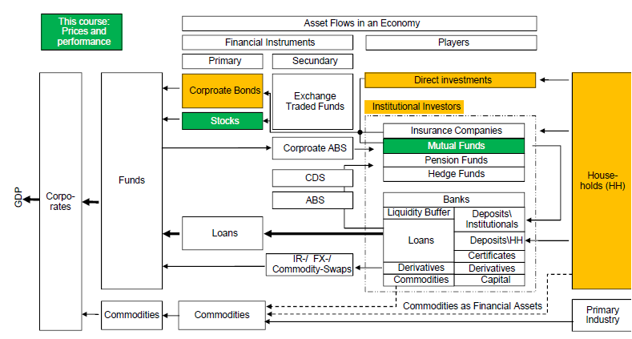
Where do banks sit in the macro economy?

Slide 7
Why do banks exist?
Bank
Corporate
Assets
Liabilities
Assets
Liabilities
Illiquid Loans
Liquid deposits
Illiquid Machines, Products, Real estate
Debt (mainly from banks)
Capital
Liquid assets
Capital
Liquid a.
The role of banking in the economy involves transformation of assets - in the maturity dimension, i.e. short liquid deposits into illiquid long loans - in the credit dimension – monitoring loans - in the volume dimension, i.e. Many small deposits into large loans - producing customized derivatives - produce liquidity reserves for households (demand deposits) - take on financial risks and manage them
This enhances economic efficiency and welfare ... but at the cost of inherently unstable banks (bank run).

Slide 8
Banks in GE (Arrow-Debreu model)
Financial Markets
B_{f} + B_{b} = B_{h}
Firms (f)
Households (h)
Assets
Liabilities
Assets
Liabilities
Investments (I)
Bonds (B_{f})
Loans (L_{f})
Bonds (B_{h}) Deposits(D_{h})
Savings S
Banks (b)
Assets
Liabilities
Loans (L_{b})
Bonds (B_{b}) Deposits(D_{b})

Slide 9
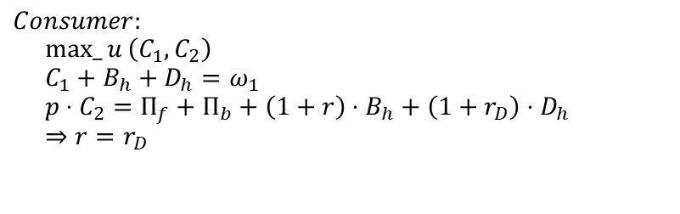



Banks in Arrow-Debreu model
$$Consumer: \\ max_{u}\left(C_{1},C_{2}\right) \\ C_{1}+B_{h}+D_{h}=ω_{1} \\ p⋅C_{2}=Π_{f}+Π_{b}+\left(1+r\right)⋅B_{h}+\left(1+r_{D}\right)⋅D_{h} \\ ⇒r=r_{D}$$
$$Equilibrium in markets: \\ I=S \\ D_{b}=D_{h} \\ L_{f}=L_{b} \\ B_{h}=B_{f}+B_{b}$$
$$Firm: \\ \max\left(Π_{f}\right) \\ Π_{f}=p⋅f\left(I\right)−\left(1+r\right)⋅B_{f}−\left(1+r_{L}\right)⋅L_{f} \\ I=B_{f}+L_{f} \\ ⇒r=r_{L}$$
Bank’s profit is always zero
The existence, size, level of competition, asset size and composition of financial sector do not have any effect either on the decision of others or on the equilibrium
”Reversed” MM theorem!
How to introduce the need for financial markets:
A-D ”securities”!
See: Oliver Blanchard: Public Debt and Low Interest Rates
$$Bank: \\ \max\left(Π_{b}\right) \\ Π_{b}=r_{L}⋅L_{b}−r⋅B_{b}−r_{D}⋅D_{b} \\ L_{b}=B_{b}+D_{b} \\ ⇒r=r_{L}=r_{D}$$

Slide 10
Why does the economy need banks in theory?
Financial Institutions trade cash, financial securities in general
In a complete, transaction cost free, perfect market without economy of scale investors and entrepreneurs are able to diversify investments perfectly and allocate risks efficiently
If any of the above conditions are not met, then a coalition of investors/borrowers is preferable
Transaction costs?!
Informational asymmetries (adverse selection, moral hazard, costly state verification)
Banks as liquidity providers (Diamond-Dybvig)
Banks as information coalitions (Leyland-Pyle)
Banks and delegated monitoring (Diamond)
…
Banks as financial intermediaries

Slide 11
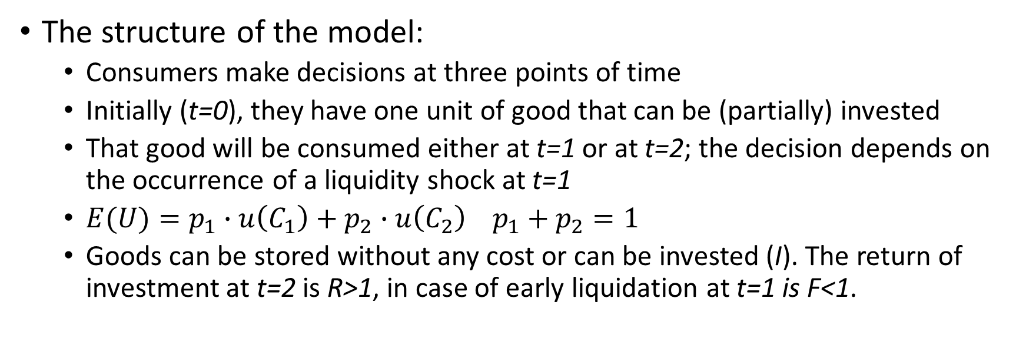
Banks as liquidity providers
The structure of the model:
Consumers make decisions at three points of time
Initially (t=0), they have one unit of good that can be (partially) invested
That good will be consumed either at t=1 or at t=2; the decision depends on the occurrence of a liquidity shock at t=1
$E(U)=p_{1}∙u\left(C_{1}\right)+p_{2}∙u\left(C_{2}\right) p_{1}+p_{2}=1$
Goods can be stored without any cost or can be invested (I). The return of investment at t=2 is R>1, in case of early liquidation at t=1 is F<1.
Diamond – Dybvig: Bank Runs, Deposit Insurance and Liquidity; Journal of Political Economy; 1983.

Slide 12
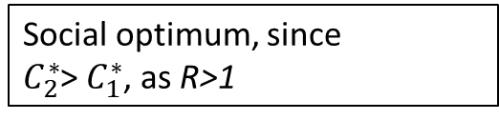

Az ex ante optimal allocation (autarky)
$\max{{ p}_{1}∙u\left(C_{1}\right)+}p_{2}∙u\left(C_{2}\right)$
st:
$p_{1}∙C_{1}$=1-I
${ p}_{2}∙C_{2}=R∙I$
$p_{1}∙C_{1}+p_{2}∙\frac{C_{2}}{R}=1$
$U^{′}\left(C_{1}^{∗}\right)=R∙U^{′}\left(C_{2}^{∗}\right)→\frac{U^{′}\left(C_{1}^{∗}\right)}{U^{′}\left(C_{2}^{∗}\right)}=R$
Probabilities are ratios in the total population
Aggregated budget constraint
Social optimum, since
$C_{2}^{∗}$> $C_{1}^{∗}$, as R>1

Slide 13

First case – No market
$C_{1}=1−I+F∙I=1−I∙\left(1−F\right)$
$C_{2}=1−I+R∙I=1−I∙\left(R−1\right)$
$C_{1}≤1,C_{1}=1, if I=0$
$C_{2}≤R,C_{2}=R, if I=1$
$p_{1}∙C_{1}+p_{2}∙\frac{C_{2}}{R}<1, not efficient!$

Slide 14
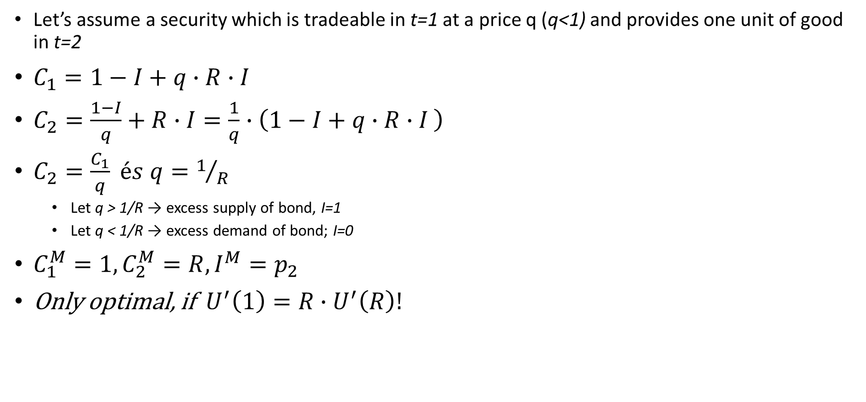
Second case – Money market
Let’s assume a security which is tradeable in t=1 at a price q (q<1) and provides one unit of good in t=2
$C_{1}=1−I+q∙R∙I$
$C_{2}=\frac{1−I}{q}+R∙I=\frac{1}{q}∙\left(1−I+q∙R∙I \right)$
$C_{2}=\frac{C_{1}}{q} és q=1/R$
Let q > 1/R → excess supply of bond, I=1
Let q < 1/R → excess demand of bond; I=0
$C_{1}^{M}=1,C_{2}^{M}=R, I^{M}=p_{2}$
Only optimal, if $U^{′}\left(1\right)=R∙U^{′}\left(R\right)!$
Bring forward the return on I, sale of R*I unit of security
Spend the excess liquidity and buys (1-I)/q unit of security

Slide 15
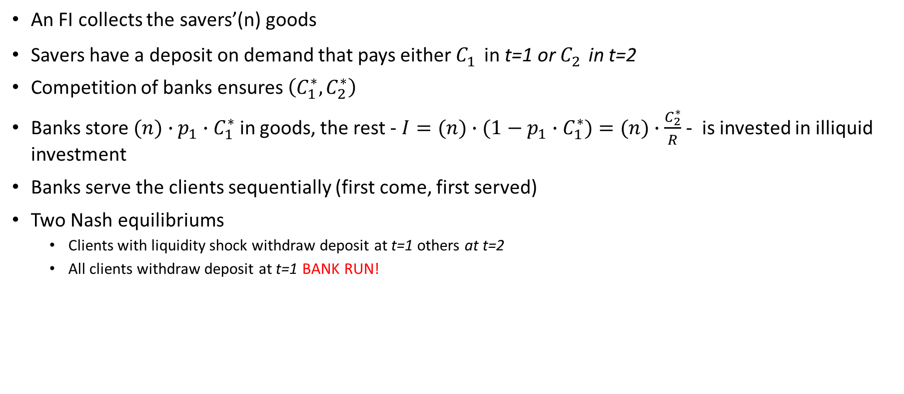
Third case – Financial Intermediation
An FI collects the savers’(n) goods
Savers have a deposit on demand that pays either $C_{1}^{}$in t=1 or $C_{2}^{}$in t=2
Competition of banks ensures $\left(C_{1}^{∗},C_{2}^{∗}\right)$
Banks store $(n)∙{p_{1}∙C}_{1}^{∗}$ in goods, the rest - ${I=(n)∙(1−p_{1}∙C}_{1}^{∗})=(n)∙\frac{C_{2}^{∗}}{R}$ - is invested in illiquid investment
Banks serve the clients sequentially (first come, first served)
Two Nash equilibriums
Clients with liquidity shock withdraw deposit at t=1 others at t=2
All clients withdraw deposit at t=1 BANK RUN!

Slide 16
Notes:
FI and money market cannot coexist
Bank runs are rational
Solution (?!):
Narrow banking
Suspension of withdrawal
Lender of last resort
Deposit insurance
How do banks beat money market?
Role of information asymmetry?
Role of diversification!

Slide 17

Answers
I. Bond supply: $p_{1}∙I=\left(1−p_{2}\right)$ $∙I$;
Bond demand: $\left(1−I\right)$ $∙p_{2}$;
$I^{∗}=$ $p_{2}$
II. AD securities
$\max{{E\left(U\right)= p}_{1}∙u\left(C_{1}\right)+}p_{2}∙u\left(C_{2}\right)$
s.t. $π_{1}∙$ $C_{1}$+ $π_{2}∙$ $C_{2}≤1$
FOC: $\frac{u^{,}(C_{2})}{u^{,}(C_{1})}=\frac{p_{2}}{p_{1}}∙\frac{π_{1}}{π_{2}}$
$π_{1}$= $p_{1}$; $π_{2}$= $\frac{p_{2}}{R}$
$\frac{u^{,}(C_{1})}{u^{,}(C_{2})}=$R

Slide 18
What have we learned so far:
Banks relate to market inefficiencies
Banking system is fragile, the reason being the special structure of banks’ balance sheets (Fractional Reserve System)
FRS is in the core of banking!
Certain risks can be managed by the banking system only
that requires financing on the asset side
Entrepreneurs’ interest is to create a coalition in order to get cheaper external financing
Further question?
Why do banks use special products on asset/liability side? (loans, deposits)?

Slide 19
Financial Institutions from an
Accounting -> IFRS9
Legal -> HIT
IT -> Core systems and payment infrastructure
Organizational
perspective.

Slide 20
A bank jövedelmezősége
Income sources of a financial institution
Transactional services
Account management
Payment services
Safe services
Sale of financial securities
Exchange of currencies
Wealth management
Asset-side services -> Risk undertakings
Granting loans -> Credit risk
Trading on own accounts -> Market risk
3. Liability-side services
Deposits
3/25/2024

Slide 21
Organization of a bank
Business services
Front Office
Large Corporates
Project financing
SME
Retail
Treasury
Mid Office
Risk Management
Controlling
Process management
Product-management
Back Office
Credit Control
Loan Administration
Payments
Custody
Card Management
Supporting areas
IT
Core systems:
Account services
Card services
Trade finance system
…
Front End systems
Data warehouse
HR
Legal
Marketing

Slide 22
Bank business and balance-sheet risk Products and their B/S, P&L- and risk implications
Service or function | Balance sheet | Revenue generated | Risk
Lending
Retail, commercial, mortgage, project finance | Assets | Interest income, fees | Credit, Market
Trade finance, credit cards | Assets | Interest income, fees | Credit, Market, Operat.
Lending, Syndicated | Assets | Trading, interest incoem, fees | Credit, Market
Cash Management
Processing | Asset [balance <0], Liabilities [balance >0] | Fees | Operational
Payments |  | Fees | Credit, Operational
Custodians | --------- | Fees | Credit, Operational
Private banking | --------- | Commission income, interest income, fees | Operational
Asset management | ---------- | Fees, Performance payments | Credit, Market, Operational
Capital markets
M&A | ---------- | Fees
Corporate finance | Aseets (if banks lends), | Fees, Interest income (if bank lends)
Trading (Equities, Foreign exchange, Derivatives) | Assets (long, MV > 0) Liabilities (short, MV<0) | Trading income, fees | Credit, Market, Operational
Trading (Bonds) | Assets (long), Liabilities (short) | Trading income, interest income, fees
Depositing (Retail, Corporate, Public sector, Interbank) | Liabilities | Interest income | Liquidity risk

Slide 23
Bank business and balance-sheet risk Products and their B/S, P&L- and risk implications
Retail & SME
Corporate
Asset-based Finance
Financial Institutions
Borrowing (client’s view)
Payment
Investment (client’s view)
Services & Extras
Loans\Overdraft Facility
Current account (-)
Saving Deposits
Government Securities
Loans\Consumption
Current account (+)
Term Deposits/ Saving certif.
Investment funds
Loans\Car
Certificates
Investment funds Saving Plan
Loans\CreditCard
Wealth Management
Mortgages\Fixed-rate
Custody
Mortgages\Variable-rate
Assets
Liabilities
Mortgages\Pre-payment Option
Other Claims
Unsecured Deposits from customers
Mortgages\Rate Locker
Mortgages (property-secured loans)
Mortgages\ Securitis. Blocker
Securitised Liabilities

Slide 24
Bank business and balance-sheet risk Products and their B/S, P&L- and risk implications
Retail & SME
Corporate
Asset-based Finance
Financial Institutions
Financing
Cash Management
Asset Management
International Business
Risk Management
Borrowing (client’s view)
Payment
Investment (client’s view)
Services & Extras
Bank financing (loans, leases)
Corporate account (-)
Money market deposits
Capital market financing
Promissory note bonds
Corporate account (+)
Term Deposits
Advisory services
Export and trade finance
Currencies
Certificates
Payment services
Bank’s own debt issuances
Cash pooling
Bank’s own equity issuances
Treasury management
Assets
Liabilities
Information management
Other Claims
Unsecured Deposits from customers
Portals and Frontends
Mortgages (property-secured loans)
Money market funds
Securitised Liabilities
Third party securities
Promissory note loans
Equity
Custody
Trading assets
Trading liabilities
Company Pension Scheme
Working time accounts
Payment services
Documentary business
Derivatives
24

Slide 25
Bank business and balance-sheet risk Products and their B/S, P&L- and risk implications
Retail & SME
Corporate
Asset-based Finance
Financial Institutions
Asset Mgt & Leasing
Real Estate Finance
Ship Finance
Public Finance
Borrowing (client’s view)
Payment
Investment (client’s view)
Services & Extras
Finance leases (real estate)
Pfandbrief
Investment funds
Operating leases
Ship Pfandbrief
Real estate loans
Public sector Pfandbrief
Ship loans
Lettres de Gage Publiques
Unsecured loans
Repo (spot sale)
RE/ infrastructure loans
Assets
Liabilities
Repo (spot purchase)
Other Claims
Unsecured Deposits from customers
Mortgages (property-secured loans)
Securitised Liabilities
Promissory note loans
Equity
Trading assets
Trading liabilities
Other assets
Secured deposits from customers

Slide 26
Bank business and balance-sheet risk Products and their B/S, P&L- and risk implications
Retail & SME
Corporate
Asset-based Finance
Financial Institutions
Money market trading
Liquidity management
Borrowing (client’s view)
Payment
Investment (client’s view)
Services & Extras
Trade loans
Correspondent banks (-)
Repo (spot sale)
Advisory services
Repo (spot purchase)
Correspondent banks (+)
UD from other banks
Payment services
Deposits to other banks
Currencies
Funding liquidity reserve
Cash pooling
Liquidity reserve
Assets
Liabilities
Other Claims
Unsecured Deposits from customers
Mortgages (property-secured loans)
Securitised Liabilities
Promissory note loans
Equity
Trading assets
Trading liabilities
Other assets
Secured deposits from customers
Claims on banks
UD from banks
SD from banks
Cash reserve

Slide 27
Bank business and balance-sheet risk Products and their B/S, P&L- and risk implications
Retail & SME
Corporate
Asset-based Finance
Financial Institutions
Money market trading
Borrowing (client’s view)
Payment
Investment (client’s view)
Services & Extras
Instruments
Products
Assets
Liabilities
Products
Instruments
Cash,
Central bank deposits
1%
Cash reserve
Liabilities to banks
18%
Repo for clients
Interbank deposits for clients
Interbank deposits
CD/ CP
Repo
Central MRO
Interbank loans
CD/ CP
Reverse notes
15%
Claims on banks
Liabilities to customers
35%
Saving/ demand deposits
Call money
Term deposits
Loans
Roll-overs
Mortgages
43%
Claims on customers
Positive FV deriv.
Assets held for trading purposes (bonds, notes, shares, FX, precious metals)
22%
Trading assets
Securitised Liabilities
17%
Senior unsecured
Covered bonds
ABS/ Securitisation
15%
Financial investments
Trading liabilities
20%
Negative FV deriv.
Bonds and notes not held for trading
Equity investments
Participations
Remaining liabilities
3%
Subordinated capital
2%
Subordinated (unsec.)
2%
Remaining assets
Hybrid capital
1%
Hybrids
1%
Other assets
Equity
4%
Common equity
Retained earnings
Irrevocable credit lines, guarantees
Back-up liquidity lines (SPV)
Collat. for downgrade
Margin calls/ repo haircuts
Contingent liabilities

Slide 28
Bank business and balance-sheet risk Products and their B/S, P&L- and risk implications
Retail & SME
Corporate
Asset-based Finance
Financial Institutions
Money market trading
Borrowing (client’s view)
Payment
Investment (client’s view)
Services & Extras
Cash flows are central for liquidity management:
Assets: generate inflows
Liabilities: generate outflows
Liquidity risk: Liabilities are (usually) of shorter term than assets => Outflows are of shorter term than inflows => Risk that outflows cannot be paid
Assets
Liabilities
1%
Cash reserve
Liabilities to banks
18%
15%
Claims on banks
Liabilities to customers
35%
43%
Claims on customers
Securitised Liabilities
17%
22%
Trading assets
Trading liabilities
20%
15%
Financial investments
Remaining liabilities
3%
2%
Remaining assets
Subordinated capital
2%
1%
Other assets
Hybrid capital
1%
Equity
4%
Inflows CF⁺_{t}
Outflows CF⁻_{t}
Liquidity Maturity Ladder = basis for any liquidity modelling

Slide 29
Credit risk undertaking process
Sales/
Targeting
Assessment
Client & Deal
Approval
Disbursement
CC&LoanAdmin.
Monitoring
Work-out

Slide 30
Assessment
Client’s risk
what is the chance that the client will not be able to honor his debt obligation ---> probability of default
Deal risk
what means the bank can use to control the client ---> Covenants
what options the bank has in case of default ---> loss given default

Slide 31
Assessment of client’s risk – steps to standardization
Individual assessment (client by client) – expert’s view
5Cs (Character, Capacity, Capital, Collateral, Cycle)
Able to pay, willing to pay
Credit Committee
Rule-based assessment
Minimum Credibility Parameters
Statistical methods
Behavioral (monitoring)
Application (new clients)

Slide 32
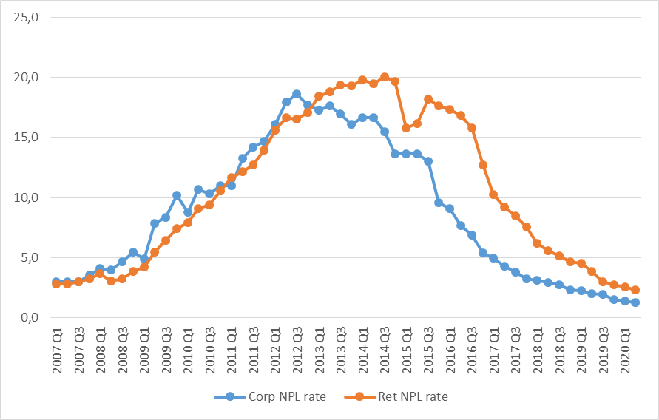
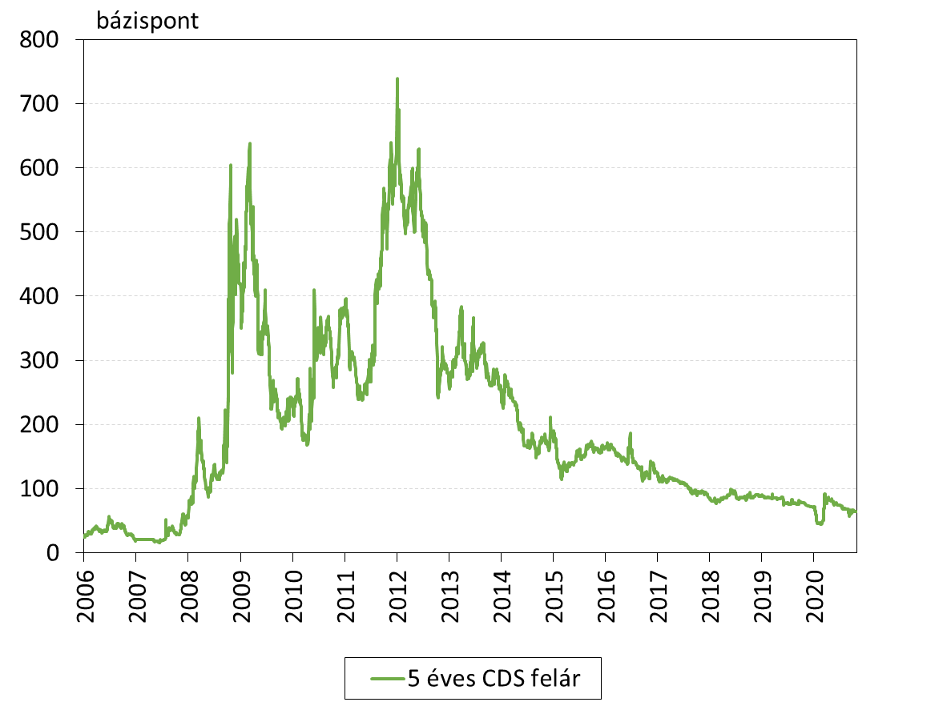
NPL ratios and CDS spread in Hungary
”Only when the tide goes out do you discover who's been swimming naked” Warren Buffett

Slide 33
Corporate-lending
Limit-system
2-round approval mechanism
Rating systems
Typical products and services
Working-capital loans
Revolving Credit Facility
Investment loans
Documentary credit, letter of credit
Transactional services
Special financing techniques
Project finance
Factoring
AgriFinance
State-subsidized products (funded or interest-rate subsidized)

Slide 34
Assessment of corporates’ risk
Internal sources
On-site interview
Bank’s own records:
Credit history
Payment history
Deposits dynamics
Treasury operations
External sources
Financial statements
Credit information systems (BISZ, D&B)
Information from Banks
Industrial Associations
Industry analysis
Disclosures
3/25/2024
Notes:
34

Slide 35
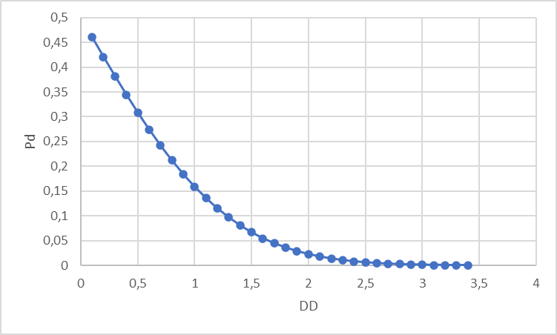
Equity-based corporate assessment
VA Value of the firm (Assets)
VE Value of the Equity (of the firm)
X Nominal value of external financing (Debt)
DD – distance to default
 | Non-default | Default
 | V>X | V<=X
Equity | V-X | 0
Debt | X | V
Pay-off=Max(V-X,0)

Slide 36
Covenants – contractual conditions
Positive covenants
Compliance with relevant regulations (incl. connected clients)
Honor tax obligations
Retain rights, licenses, patents, etc. to carry on with business activity
Retain assets
Pari passu
Negative covenants
Negative pledge
Forbid further indebtedness
Forbid mergers and acquisitions
Forbid the sale of assets
Forbid to change core business activity
Forbid to change accounting standards
Forbid to pay dividend
No significant change in ownership structure
Cross default
Financial covenants
Debt service / EBITDA
DSCR (debt service coverage ratio)
DSRA (debt service reserve account)
36
Notes:
36

Slide 37
Collaterals, sureties, pledges
Personal guarantee
Deficiency surety
Joint and several surety
Bank guarantee
Guarantee issued by Guarantor Institution
State surety
Letter of Credits
Material collaterals
Pledge
Security deposit
Current account/escrow account
Deposit
Financial securities
Ware receipt
Hypothecation
Mortgages
3/25/2024
37
Notes:
37

Slide 38
First Case Study here

Slide 39
Retail lending
Customers: Private individuals and micros
Lending products
Credit Cards
Overdraft
Personal loans
Mortgage loans
Housing
Home Equity („szabadfelhasználású”)
Unit-linked combined
Reverse mortgage
State-sponsored products (p.e.: „Babaváró”)
Special constructions to micro
”Patika” loan, ”Széchenyi” card
Factoring
Leasing
Deal-based approval
Code of Conduct
361/2009 Government decree on responsible lending
32/2014 MNB decree on DSCR (Jövedelemarányos Törlesztési Mutató)
Loan to Value (LTV)
Standardized assessment and approval

Slide 40
Statistical methods in client assessment: Naiv Bayes estimation
Rank clients by conditional PD
p(.) is the conditional PD under some x vector
n, N cardinality of the relevant sets
define appropriate decision rules
Independence
Log-odds ratio
Weight of Evidence

Slide 41
Monitoring
Corporate monitoring:
Identify firms where something may go bad in the future
Continue financing, strengthen the covenants
Soft exit
Hard exit
Individual decisions
Retail monitoring
How do clients honor their debt service?
What is the payment behavior of clients?
Strong connection to CRM
Rule-based decisions

Slide 42
Payment systems: concepts and the legal framework
Payment: Transfer of value between sender (payer) and receiver (payee)
Standardized messages between economic actors on different software and hardware platforms
Open-loop vs closed-loop systems
Push vs pull transactions
On-us vs off-us transactions
Payment Service Directive I. - 2007
Payment service provider
Single European Payment Area - SEPA
Payment Accounts Directive – 2014
Transparency and comparability
Payment Service Directive II. – 2015 -> 2019
2-factor authentication
Payment initiation service provider
Account information service provider
Open API

Slide 43
Core Payment systems
Cash -> Central Bank Digital Currency
Check -> PEK
Automated Clearing House (ACH) -> BKR, GIRO
Wire transfer -> SWIFT, telex
Card -> MasterCard, Visa
Examples for basic transactions
Payment or transfer order (átutalási megbízás)
Direct debit (beszedési megbízás)
Warrant for payment (fizetési meghagyás)
Request for payment (fizetési kérelem)

Slide 44
Elements of payment systems (open-loop)
Transactions of payment service providers
Financial institutions
(intermediaries)
Clearing Houses
Settlement

Slide 45
Example: Cards
Settlement bank
Issuing bank
Interchange fee
Acquiring bank
Card-processor
Card Company
Owner
Merchant/POS
In case of a purchase, the acquirer pays to the issuer
In case of cash withdrawal (ATM) issuer pays to the owner of ATM (acquirer)
Cashback, chargeback

Slide 46
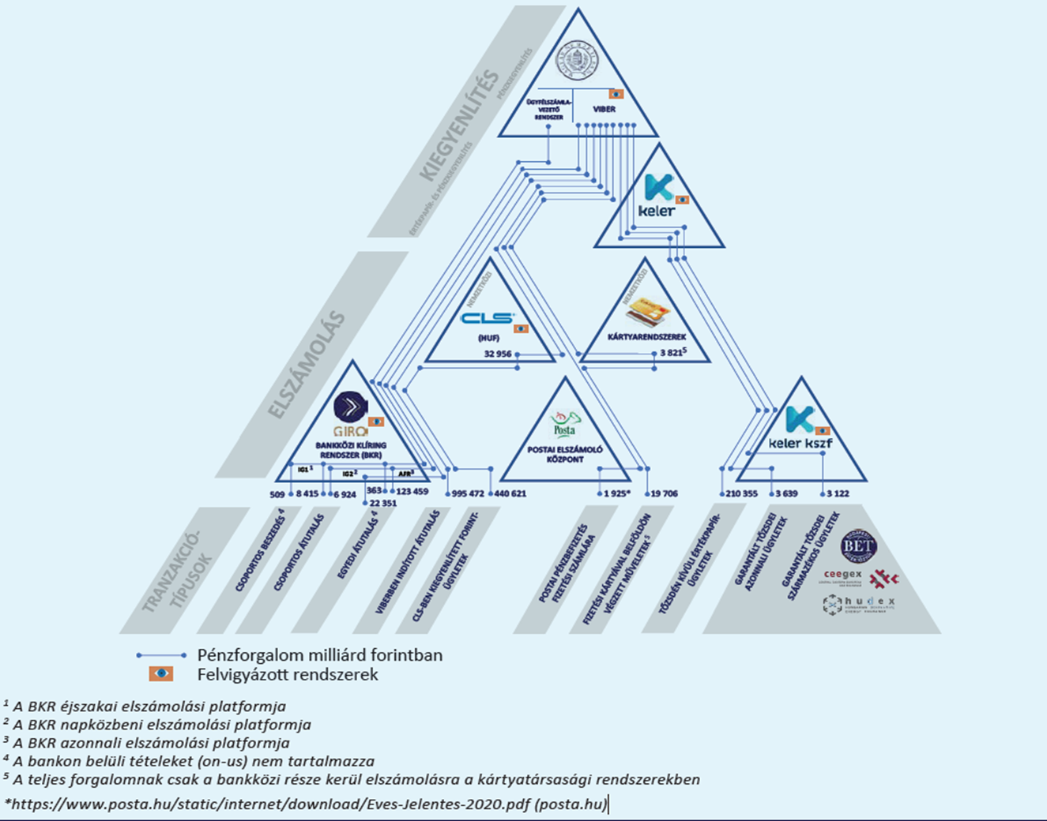
Example: Hungarian payment system (2021)

Slide 47
International payment system
SWIFT – Society for Worldwide Interbank Financial Telecommunication – payment orders, confirmation
nostro/loro account – settlement
SEPA – Single European Payment Area – EUR only, special SWIFT messages
Nostro/loro account – settlement
Clearing, Settlement Houses – Target2

Slide 48
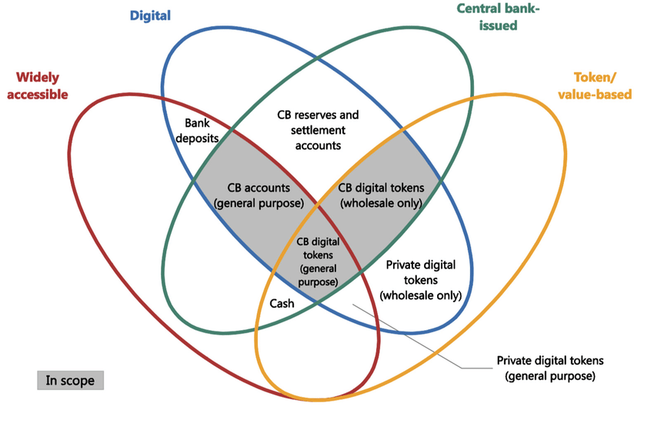
Money-flower

Slide 49
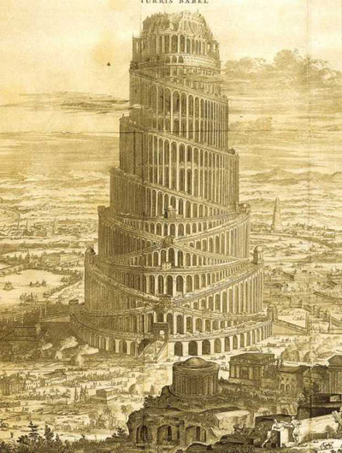
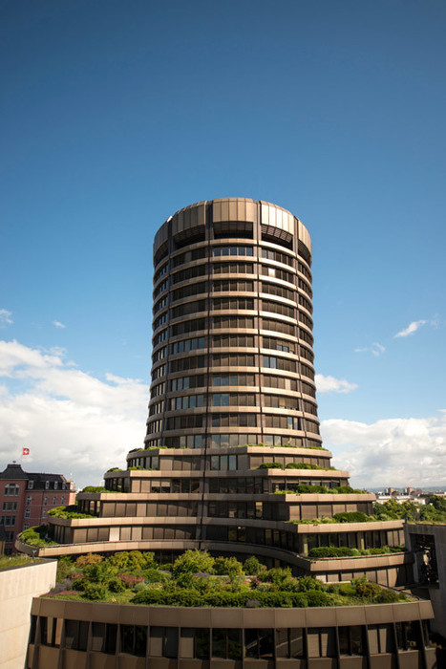
Recognize these?
The Tower of Babel
The Tower of Basel

Slide 50
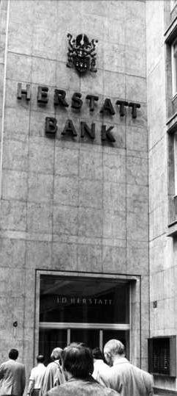
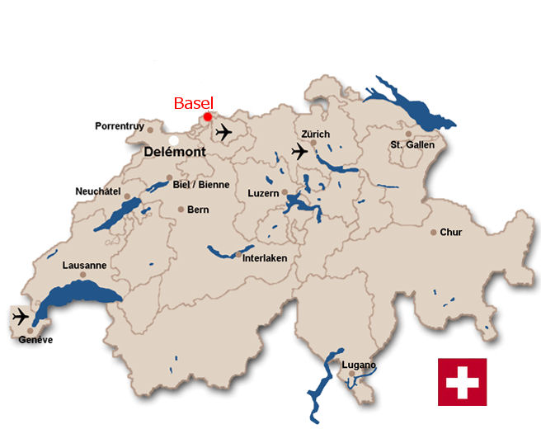

From the Herstatt Bank failure to the Basel Committee on Banking Supervision
Herstatt Bank was a privately owned bank in Germany (Cologne), which went bankrupt on the 26th of June 1974
In the lead up to the bankruptcy - a number of banks had released payment of DEM (Deutch Marks) to Herstatt in Frankfurt in exchange for USD that was to be delivered in New York. Because of time-zone differences, Herstatt ceased operations between the times of the respective payments and the counterparty banks did not receive their USD payments
On June 26, 1974, German regulators forced the ‘troubled’ Bank Herstatt into liquidation. This type of settlement risk, in which one party in a foreign exchange trade pays out the currency it sold but does not receive the currency it bought, is sometimes called Herstatt risk
Responding to the cross-jurisdictional implications of the Herstatt debacle, the G-10 formed a standing committee under the auspices of the Bank for International Settlements (BIS)
Called the Basel Committee on Banking Supervision (BCBS), the committee comprises representatives from central banks and regulatory authorities

Slide 51
Why regulate banks?
Cost of bankruptcy is higher for the society than for the owners of a bank
Bankruptcy recreates assymmetric information
Chance for contangion is higher because of the fragility of the banks -> the whole banking system might collapse
Modern money is a bank liability!
High bankruptcy cost in case of small depositors
Protect depositors?
Higher capital, higher safety? Risk -> Capital
Types of risks:
Market
Liquidity
Credit
Interest rate
Settlement
Reputational
Operational
…

Slide 52
Regulation of Banks
Organizational rules
What kind of enterprises can provide financial services?
Procedural rules
What can Financial Institutions do?
Regulatory tools
Interest rate regulations
Constraints on mergers and entry
Limits on portfolios, reserves
Deposit insurance
Capital requirements
Liquidity requirements
Supervisory control

Slide 53
What is capital and why is it important?
What is Capital?
Capital is the money that a bank has obtained from its shareholders and other investors plus any profit that it has made and not paid out (retained earnings)
Banking Balance Sheet
Net Advances
Total (gross) Advances
Home Loans
+ Credit Cards
+ Car Loans
+ Company Loans
+ Structured Products
- Non-performing Advances
Wholesale Assets
Securities lent
+ Repos
Inter Company Assets
Goodwill
Total Assets
Deposits
Retail Deposits
Wholesale Deposits
Wholesale Liabilities
Securities borrowed
+ Reverse Repos
Inter Company Liabilities
Debt
Senior Debt
+ Mezzanine Debt
+ Subordinated Debt
Total Liabilities
Common Equity Tier 1 Capital
Common Equity
+ Retained Earnings
Additional Tier 1 Capital
Tier 2 Capital
Preference Equity
+ Other Equity Instruments
Total Equity
Why is Capital important?
Capital is the primary financial cushion against losses, whether caused due to defaults, fair value declines or other reasons
Statutory (IFRS) capital does not fully reconcile with regulatory (Basel) capital, even though the former is constrained by the latter

Slide 54
Capital components for regulatory capital
Risk Weighted Assets
Capital Components
Paid in Capital
CET1 capital instruments (shareholder equity)
Capital reserves
Majority of capital; low volatility, generally changing only as part of increases in capital stock
Profits
Retained earnings, interim profits & Other Comprehensive Income (profits only testified, losses immediately)
Corrections for Own Credit Risk and Debt Valuation Adjustments (gains from decrease of own creditworthiness cannot be considered)
Corrections for goodwill & immaterial assets
Other large part of capital; more volatile than capital components
Prudent Valuation & IRB Shortfall
Fair Value Adjustments in line with IFRS13
Shortfall/Excess of IRB-EL over Impairments (shortfall to be subtracted, excess can be used up to 0.6% of Tier 2 capital)
Materiality generally low to medium, but high volatility
Tax and Financial Investment
Correction for tax assets assuming future profits
Correction for large CET1 and AT1 financial investments
Deferred tax potentially important, thresholds for FI rather high
AT1 and T2 Capital Instruments
AT1: ContingentConvertibles (transforming to equity latest at 5.25% CET1-Ratio), preferred stock
T2: Subordinated Debt
Importance decreasing, Grandfathering agreements ran out end of 2017

Slide 55
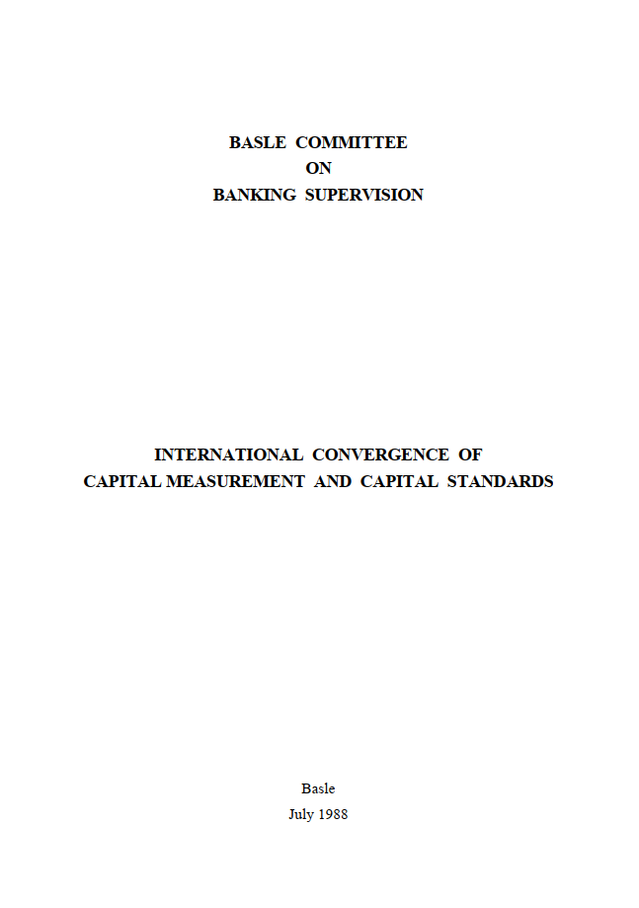
The 1988 Basle Capital Accord (Basel I)
Basel I was introduced in 1988 with two fundamental objectives:
To “strengthen the soundness and stability of the international banking system”
To provide “a high degree of consistency in its application to banks in different countries with a view to diminishing an existing source of competitive inequality among international banks”
Risk Weight | Example
0% | Cash Claims on central governments
10% | Claims on domestic public sector entities (national discretion)
20% | Claims on or guaranteed by banks incorporated in the OECD Cash items in the process of collection
50% | Loans fully secured by mortgage on residential property
100% | Claims on the private sector (ex. residential mortgages) Fixed assets Capital instruments issued by other banks

Slide 56

The 1996 Market Risk Amendment
The focus of the original Basel framework was on credit risk and as such was enhanced in 1996 by the Market Risk Amendment in order to cover the risks embedded in the trading book
Market Risk | Options and variables
Types | General Market Risk Changes in market values due to large market movements | Specific Market Risk Changes in the value of an individual asset due to factors related to the issuer of the security
Variables | Interest rates Foreign Exchange Equities Commodities
Approaches | Standardised | Internal VaR models
Eligible capital | The 1996 revision added a third tier for total capital, which includes short-term unsecured debts
Modified by subsequent Market Risk revisions

Slide 57
From Basel I to Basel II
Basel I and Basel II
1973
1974
1988
1996
1999
2002
2004
2005
2006
The Market Risk Amendment is introduced
Basel II consultative papers
Basel Committee on Banking Supervision gets established
Basel II Go live
Basel II is issued
The Basel Capital Accord (Basel I) is introduced
Amendment to the Capital Accord to incorporate Market Risks (including Trading Activities)
Basel Committee issues a proposal for a revised capital framework
“The fundamental objective [of Basel II] has been to develop a framework that would further
strengthen the soundness and stability of the international banking system while maintaining sufficient consistency that capital adequacy regulation will not be a significant source of competitive inequality among internationally active banks”

Slide 58

Well, the objectives were not quite achieved…

Slide 59
And Basel III arrived a lot faster than expected…
Basel III
2009
2010
2011
2012
2013
2014
2015
2016
2017
2018
2019
2022
2023
2027
LCR final
Beginning of Basel III phase in
Market Risk revisions (Basel 2.5)
NSFR final
Minimum capital reqts for Market Risk introduced
IRRBB implementation
Revised (post Covid) implementation date
Basel III final publication
Finalisation of Basel III standards
End of Basel III roll out timeline incl Output floors
With even further refinements in 2017, euphemistically termed ‘Basel IV’

Slide 60
Basel III is an extension, not a replacement of Basel II
Basel I
Basel II
Basel III
Main contributions
First standardised capital framework for Credit and Market Risk
Better risk sensitivity
Introduction of internal approaches for Credit Risk
Explicit capital requirements for Ops risk
Supervisory review (Pillar 2) & public disclosures (Pillar 3)
Strengthening quantity and quality of capital
Better risk coverage for Market Risk, CCR, securitisations
Non-risk sensitive leverage ratio
Lower reliance on internal modelling assumptions
Explicit liquidity standards
Shortcomings
Limited differentiation of risk
No recognition of term structure of risk
Lack of recognition of portfolio diversification (and concentration) effects
Inadequate treatment of securitisation structures
Insufficient quantity of capital
Insufficient quality of capital
Procyclical nature of capital standards
Large divergence of capital requirements, even for similar portfolios
?
Complexity?
Shifting of financial activity to non regulated sectors (shadow banking)?

Slide 61
The core structure of Basel II and Basel III
MEASURE - Minimum Capital Requirements & Liquidity Standards
Advanced calculation of required capital for Credit, Market & Operational Risk
Permits selection of calculation method (subject to regulatory approval)
Liquidity standards (Basel III)
Pillar 1
MANAGE - Self Assessment & Supervisory Review
Establishment of Capital & Liquidity adequacy assessment process (ICAAP & ILAAP)
A comprehensive assessment of risks (i.e. beyond Pillar 1) as well as a consistent supervisory assessment of banks’ capital adequacy
Evaluation and review by Regulator
Pillar 2
REPORT - Market Discipline
Required risk disclosures in addition to existing statutory disclosure requirements
Increased disclosure of risk-relevant information and thus fosters market discipline
Assessed by Markets
Pillar 3

Slide 62
From Basel III in 2010 to Basel III in 2017 –
 | Increase the level and quality of capital | Enhance risk capture | Constrain bank leverage | Improve bank liquidity | Limit procyclicality
Introduced in 2010 | Banks required to maintain more capital of higher quality to cover unexpected losses Minimum Tier 1 capital rises from 4% to 6%, of which at least three quarters must be the highest quality Global systematically important banks (G-SIBs) are subject to additional capital requirements | Capital requirements for market risk rise significantly Requirements are calculated based on 12 months of market stress Credit Valuation Adjustment risk is included in the framework | A leverage ratio constrains the build-up of debt to fund banks' investment and activities, reducing the risk of a deleveraging spiral during downturns | The Liquidity Coverage Ratio requires banks to hold sufficient liquid assets to sustain them for 30 days during times of stress The Net Stable Funding Ratio encourages banks to better match the duration of their assets and liabilities | Banks retain earnings to build up capital buffers during periods of high economic growth so that they can draw them down during periods of economic stress
Introduced in 2017 |  | Revisions to the SAs mean greater risk sensitivity and comparability Constraints on using internal models aim to reduce unwarranted variability in banks' RWAs An output floor limits the benefits banks can derive from using internal models to calculate minimum capital requirements | G-SIBs are subject to higher leverage ratio requirements

Slide 63

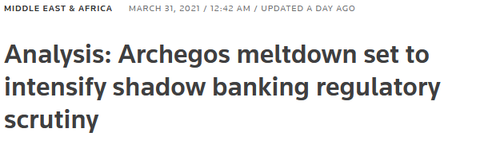
Are we (already) heading for a Basel 5?
Up until recently, the dominant view was that by shifting risky activity outside of the banking sector, financial system resilience was improves
A large number of hedge funds have folded over the last few years with minor side effects to the wider system
However, the interlinkages in the financial system became more apparent after the collapse of Archegos Capital Management in March 2021
Several large banks (Credit Suisse, Nomura), acting as Prime Brokers for Archegos, had to force liquidate positions to cover potential losses from unmet margin calls
According to JP Morgan, banks could book losses as high as $10 billion directly related to the Archegos collapse
Question: should the ‘shadow banking’ industry be regulated?

Slide 64
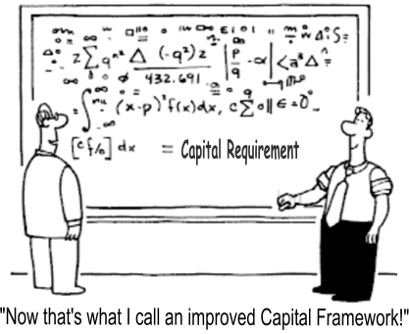

Slide 65
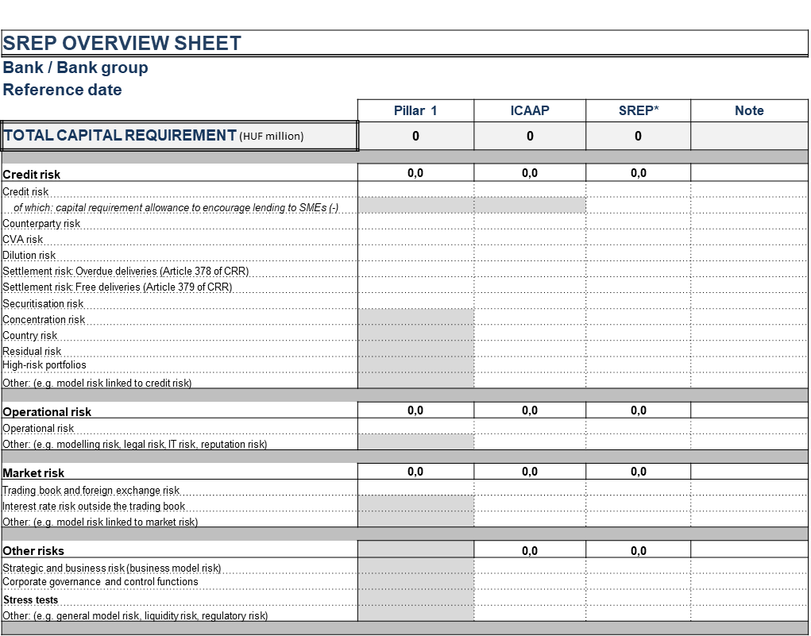
Result of SREP

Slide 66
Pillar 1 – Minimum Capital Requirements Approaches per risk type
Standardised Approaches
Internal Model Approaches
Credit
Risk
Standardised Approach
Internal Ratings Based Approach (IRB)
Retail
Foundation
Advanced
Securitisations
Standardised Approach (SEC-SA)
Internal Assessment Approach (SEC-IAA)
External Ratings Based Approach (SEC-ERBA)
Internal Ratings Based Approach (SEC-IRBA)
Counterparty
Credit
Risk
Standardised Approach (SA-CCR)
Internal Models Method (IMM-CCR)
Basic CVA (BA-CVA)
Standar’d CVA (SA-CVA)
Internal Models Method (IMA-CVA)
Market
Risk
Standardised Approach
Internal Models Approach (IMA)
Operational
Risk
Standardised Measurement Approach
Basic Indicator Approach
Advanced Measurement Approach (AMA)
Standardised Approach
Alternative Standardised Approach
Removed by 2017 Basel III updates

Slide 67
Pillar 2 – Self assessment & supervisory review Core principles
The main objective of Pillar 2 is to identify risk factors not captured in Pillar 1, giving regulators discretion to adjust the regulatory capital requirement against that calculated under Pillar 1
Pillar 2 requires banks to think about the whole spectrum of risks they might face (e.g. interest rate risk, systemic risk, pension risk, concentration risk, strategic risk, reputation risk, liquidity risk, legal risk)
The supervisory review process is based on four key principles
Principle 1
Banks should have a process that assesses their overall capital adequacy in relation to their risk characteristics, as well as a strategy for maintaining their capital levels.
Principle 2
Supervisors should review a bank’s internal capital adequacy assessments and follow up as needed.
Supervisory Review Process
Principle 3
Supervisors should specify their expectation for banks to operate above the minimum regulatory capital ratios.
Principle 4
Supervisors should intervene at an early stage to prevent capital from falling below the level required to support a bank’s risk profile.

Slide 68
Pillar 3 – Market discipline Quantitative and qualitative disclosures
The main objective of Pillar 3 is to encourage market discipline by developing a set of disclosure requirements which will allow market participants to assess key pieces of information
Market Discipline
Qualitative disclosures
Quantitative disclosures
Capital structure
Tier 1 with breakdowns
Tier 2, deductions, total eligible capital
Capital adequacy
Credit risk, equity in IRB, market risk, operational risk
Total and Tier 1 capital
Risk exposure and assessment
General qualitative disclosure of –
Strategies and processes
Organisation of risk management function
Scope and nature of risk reporting and measurement
Policies for and monitoring of hedging and mitigation
Credit risk
Definitions of past due, impaired; allowance approaches, policies
Additional requirements under IRB approaches
Market risk
Capital requirements for interest rate risk, equity position, FX and commodity
Operational risk
Description of approaches
Advance Measurement Approach (AMA) factor and insurance
Liquidity risk
LCR
NSFR
Banking book equities
Investment values, public/private, gain/loss from sale, group requirements
Banking interest rate
Value change for rate shock broken down by currency

Slide 69
Basel capital standards are the sum of various risk types and additional buffers
Pillar 2A
Other risks (IRRBB, Pension)
Tier 2
Additional
Tier 1
Buffers
Other prudential buffers *
Core Equity
Tier 1
Capital conservation buffer
Systemic buffer
Total Capital demand
≤
Total Capital supply
Countercyclical buffer
Pillar 1
Ops Risk
Market Risk
Bar sizes are illustrative
Buffers should be covered by CET 1 capital
Credit Risk
* E.g. the PRA Buffer in the UK

Slide 70

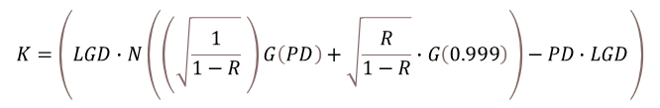
Pillar 1: Credit Risk
Basel 1 used a rudimentary approach to calculating Risk Weighted Assets (RWA) based on reference risk weights per asset class i
Basel 2 (and 3) improved the risk sensitivity of the Credit Risk framework by introducing a portfolio invariant model
In such a model the capital required for any given loan only depends on the risk of that loan and not on the portfolio it is added to
Portfolio invariancy was achieved by using an Asymptotic Single Risk Factor (ASRF) model whereby
idiosyncratic risks associated with individual exposures tend to cancel out one-another and
only systematic (or system-wide) risks, that affect all borrowers (like industry or regional risks) are modelled with only one (the “single”) systematic risk factor
The Basel 2/3 formula is based on risk parameters (PD, LGD, EAD) and allows for different levels of sophistication in their estimation (Foundation and Advanced Internal Ratings Based (IRB) approaches)
Parameter | Foundation IRB approach | Advanced IRB approach
PD | Internal estimate | Internal estimate
LGD | Supervisory estimate | Internal estimate
EAD | Supervisory estimate | Internal estimate
$$K=\left(LGD∙N\left(\left(\sqrt{\frac{1}{1−R}} \right)G\left(PD\right)+\sqrt{\frac{R}{1−R}}∙G\left(0.999\right)\right)−PD∙LGD\right)$$
$$∙\frac{1}{1−1.5b}∙\left(1+\left(M−2.5\right)b\right)$$
While a significant improvement from Basel 1, the Basel 2/3 has the following shortcomings:
Name level concentrations are not captured: Same capital charge for highly concentrated or diversified portfolios
Sector concentrations are not adequately quantified: Highly diversified portfolios will receive a high RegCap compared to ECap as formula assumes 100% correlation between different sectors
Universal formula cannot fit to all kinds of portfolios: The IRB formula was originally calibrated in such a way that even highly concentrated (European) banks receive a sufficient RegCap charge at a particular confidence level

Slide 71
Pillar 1: Credit Risk A look under the bonnet
Assuming a constant LGD of 45% and EAD of 100, the ASRF function of the Basel Committee has the following behaviour against increasing PDs
EL is naturally upward sloping (EL = PD * LGD * EAD)
UL is sloping upwards up until about a PD of 30%; afterwards it starts declining and it reaches 0% when PD tends to 100%
The ASRF model assumes that only systematic risk affect borrowers
The larger the default probability of the counterparty, the more its Unexpected Losses are driven by idiosyncratic factors; therefore the systematic-factor driven UL drops
When the counterparty has defaulted, the impact of systematic factors on UL is zero; the economy has reasonably not defaulted
The rationale between the SME adjustment (refer to boxed formula in previous slide) is largely similar
The larger a firm, the greater its dependency upon the overall state of the economy; therefore, asset correlations increase with firm size
Smaller firms are more likely to default for idiosyncratic reasons

Slide 72

Credit Risk measurement based on tail-risk
Capital Requirement
$$PD\left(X_{q}\right)∙\overline{LGD}∙\overline{EAD}$$
P&L
Expected Loss-IFRS9
x% quantile - CRR

Slide 73
General framework of latent variable credit risk models
Reduced form (CreditRisk+)
Equity based (Creditmetrics)
Gamma distribution
Std. normal dist.
Threshold
Unconditional PD
Conditional PD

Slide 74
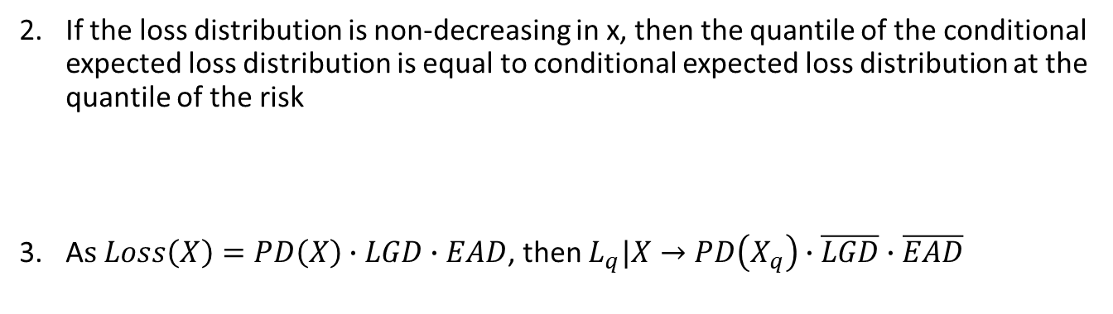

Latent variable credit risk models – a special case
Asymptotic Single Risk Factor (ASRF) model:
If a portfolio is well-diversified, the the loss distribution - L(x) - limit in portfolio size is the conditional expected loss a risk
If the loss distribution is non-decreasing in x, then the quantile of the conditional expected loss distribution is equal to conditional expected loss distribution at the quantile of the risk
A$s Loss\left(X\right)=PD\left(X\right)∙LGD∙EAD$, then $L_{q}|X→PD\left(X_{q}\right)∙\overline{LGD}∙\overline{EAD}$
$$E\left[L_{q}|X\right]=E\left[L|X_{q}\right]$$

Slide 75
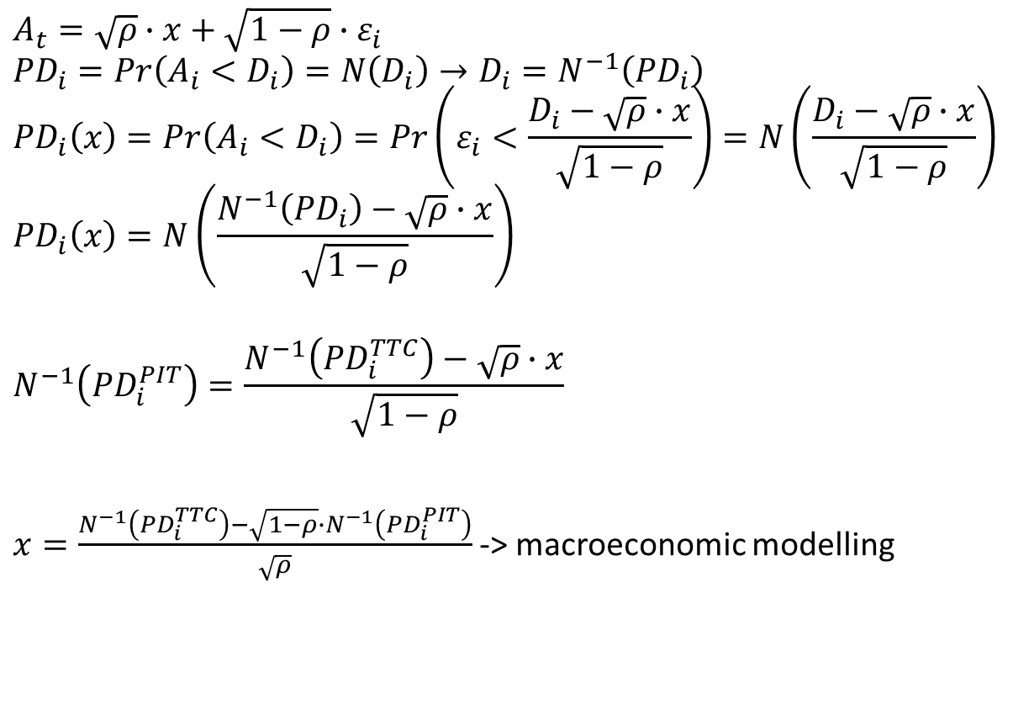
CRR specification
$$A_{t}=\sqrt{ρ}∙x+\sqrt{1−ρ}∙ε_{i}$$
$${PD}_{i}=Pr\left(A_{i}<D_{i}\right)=N\left(D_{i}\right)→D_{i}=N^{−1}\left({PD}_{i}\right)$$
$${PD}_{i}\left(x\right)=Pr\left(A_{i}<D_{i}\right)=Pr\left(ε_{i}<\frac{D_{i}−\sqrt{ρ}∙x}{\sqrt{1−ρ}}\right)=N\left(\frac{D_{i}−\sqrt{ρ}∙x}{\sqrt{1−ρ}}\right)$$
$${PD}_{i}\left(x\right)=N\left(\frac{N^{−1}\left({PD}_{i}\right)−\sqrt{ρ}∙x}{\sqrt{1−ρ}}\right)$$
$$N^{−1}\left({PD}_{i}^{PIT}\right)=\frac{N^{−1}\left({PD}_{i}^{TTC}\right)−\sqrt{ρ}∙x}{\sqrt{1−ρ}}$$
$x=\frac{N^{−1}\left({PD}_{i}^{TTC}\right)−\sqrt{1−ρ}∙N^{−1}\left({PD}_{i}^{PIT}\right)}{\sqrt{ρ}}$ -> macroeconomic modelling
Std normal dist.
TTC -> capital calc
PIT -> IFRS9 provision

Slide 76
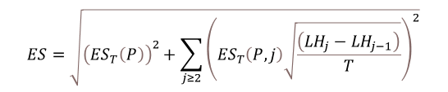
Pillar 1: Market risk capital standards (‘FRTB’)
The Standardised Approach for Basel Market Risk
The Internal Models Approach
Sensitivities based method
Default risk charge (DRC)
Residual risk add-on (RRAO)
Upon the explicit approval of a bank’s supervisory authority, the use of an internal model for the measurement of market risks is permitted, subject to explicit qualitative and quantitative standards. At a minimum, banks are required to calculated an ES on a daily basis for the bank-wide internal model, as well as for each trading desk, at a 97.5th percentile, one tailed confidence interval.
Delta risk
Linear risk
Vega risk
Linear risk, options only
+
+
Curvature risk
Non linear risk
Risk classes
General Interest Rate Risk (GIRR)
Credit Spread Risk (CSR): non securitisation
CSR: securitisation
CSR: securitisation correlation trading portfolio (CTP)
Foreign Exchange (FX) risk
Equity risk
Commodity risk
Default risk: non securitisation
Default risk: securitisation
Default risk: securitisation correlation trading portfolio (CTP)
Applied to instruments with non-linear pay offs
Based on notional amounts
$$ES=\sqrt{{\left({ES}_{T}\left(P\right)\right)}^{2}+\sum_{j≥2}{{\left({ES}_{T}\left(P,j\right)\sqrt{\frac{\left({LH}_{j}−{LH}_{j−1}\right)}{T}}\right)}^{2}}}$$

Slide 77
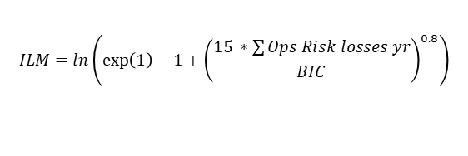
Pillar 1: Operational Risk
After years of heavy investment by banking institutions, the Basel Committee decided to do away with the Advanced Measurement Approach (AMA) for Operational Risk as well as the Basic Indicator Approach (BIA) and Alternative Standardised Approach (TSA/ASA)
The 2017 Basel updates introduce a single non-model based method for the calculation of operational risk capital, the Standardised Measurement Approach (SMA)
SMA capital charge
=
Business Indicator Component (BIC)
*
Internal Loss Multiplier (ILM)
The sum of:
Interest, Leases & Divident component (ILDC)
Minimum (Absolute Value [Interest income –
Interest expense]; 3.5% *Interest earning assets) + Dividend income
The Loss Component (LC) is defined as 15 times the average annual operational risk losses over the previous 10 years (therefore introducing some risk sensitivity to the framework)
Services component (SC)
SC = Maximum (Fee income; Fee expense) +
Maximum (Other operating income; Other operating expense)
$$ILM=ln\left(\exp\left(1\right)−1+{\left(\frac{15 ∗\sum{Ops Risk losses yr}}{BIC}\right)}^{0.8}\right)$$
Financial component (FC)
FC = Absolute value (Net P&L Trading book) +
Absolute value (Net P&L Banking book)

Slide 78
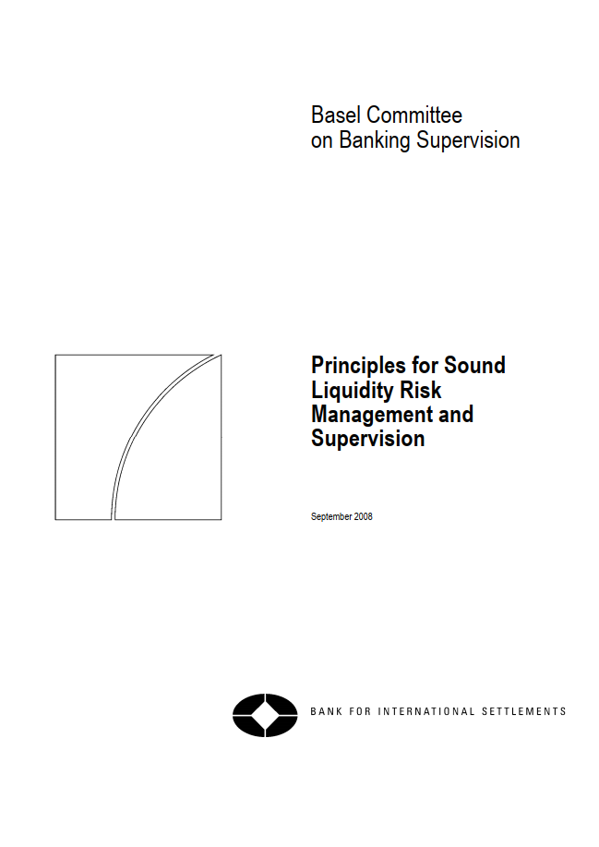
Basel III introduced explicit liquidity capital standards (a bit late, but better late than never…)
Strong capital requirements are a necessary condition for banking sector stability but by themselves are not sufficient
A strong liquidity base is of equal importance
In the lead up to and during the financial crisis many banks did not manage their liquidity prudently
Until the publication of Basel 3 there was no internationally harmonised liquidity standard
Ironically, the Basel Committee had been preparing its “Principles for sound liquidity risk management and supervision” but only got to publish them days after Lehman Brothers collapsed

Slide 79
What is liquidity risk?
One needs to differentiate between funding liquidity and trading liquidity risk
Funding liquidity risk
“The risk that the firm will not be able to efficiently meet both expected and unexpected current and future cash flow and collateral needs without affecting either daily operations or the financial condition of the firm.”
Basel Committee on Banking Supervision, 2006
Trading liquidity risk
“The risk that a firm cannot easily offset or eliminate a position without significantly affecting the market price because of inadequate market depth or market disruption.”
Basel Committee on Banking Supervision, 2006
Focus of Basel Liquidity Standards
Focus of Basel Market Risk Standards

Slide 80
What does funding liquidity mean and what are its causes?
The capability of a financial firm to maintain an equilibrium between financial inflows and outflows over time
The capability of a financial firm to increase its liabilities (acquire funds) on the wholesale financial markets when the funding is needed
The capability of a financial firm to turn an asset into cash quickly, without capital loss or interest penalty (closely linked to trading liquidity)
Causes of funding liquidity risk
Endogenous (firm specific)
Transaction and product driven sources:
Unanticipated market movements or events (bankruptcy, default, or ratings downgrade) cause demand for additional collateral from counterparties
Derivatives, off-balance sheet instruments and on-balance sheet contracts with embedded optionality result in unexpected cash outflows that need to be funded
Event driven sources: ratings downgrades or other negative news leading to a loss of market confidence in a firm (e.g. limiting ability to refinance or to access capital markets)
Exogenous (market induced)
Funding sources: movement to more volatile funding sources, such as wholesale funds
Customer behaviour: Internet banking, and depositors’ ability to switch funds among accounts by electronic means etc.

Slide 81
Basel III liquidity risk standards The Liquidity Coverage Ratio (LCR)
Stock of high – quality liquid assets
Total net cash outflows over the next 30 calendar days
≥ 100%
Objective
To ensure that a bank maintains an adequate level of unencumbered, high-quality liquid assets that can be converted into cash to meet its liquidity needs for a 30 calendar day time horizon under a significantly severe liquidity stress scenario specified by supervisors
Analysis
To qualify as a high-quality liquid asset, an asset should be liquid in markets during a time of stress.
Typically these assets are eligible at central banks for intraday liquidity needs.
The characteristics in the diagram to the right outline the fundamental and market related causes of liquidity.
High-quality liquid assets can either be classified as level 1 or level 2
Characteristics of high-quality liquid assets
Fundamental characteristics
Low credit and market risk
Ease and certainty of valuation
Low correlation with risky assets
Listed on a developed and recognised exchange market
Market-related characteristics
Active and sizable market
Presence of committed market makers
Low market concentration
Flight to quality

Slide 82
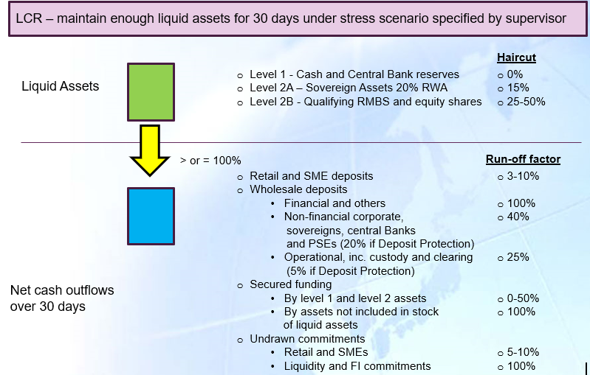
Basel III liquidity risk standards The Liquidity Coverage Ratio (LCR)

Slide 83
Basel III liquidity risk standards The Net Stable Funding Ratio (NSFR)
Available amount of stable funding
Required amount of stable funding
≥ 100%
Objective
To promote resiliency over longer-term time horizons by creating additional incentives for banks to fund their activities with more stable sources of funding on an ongoing structural basis
Analysis
The NSFR aims to limit over-reliance on short-term wholesale funding during times of market liquidity and encourages better assessment of liquidity risk across all on- and off-balance sheet items
The approach incentivises institutions to fund their stock of high-quality liquid assets with funds other than those that mature just outside the 30-day horizon
The metric establishes a minimum acceptable amount of stable funding based on the liquidity characteristics of an institution’s assets and activities over a one year horizon
Available Stable Funding (AFS)
Capital
Preferred stock with maturity of equal to or greater than one year
Liabilities with effective maturities of one year or greater
Non-maturity deposits, term deposits, unsecured wholesale funding (maturity <1 yr)
Multiplied by an allocated ASF factor
Required Stable Funding (RFS)
The sum of the value of assets held and funded by the institution, multiplied by a specific factor assigned to each particular asset type, added to the amount of off-balance sheet activity multiplied by its associated RSF factor

Slide 84
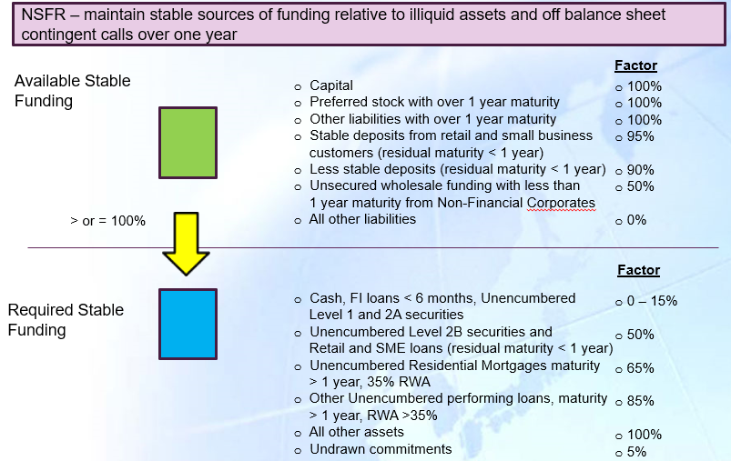
Basel III liquidity risk standards The Net Stable Funding Ratio (NSFR)

Slide 85

Worked example of LCR calculation
Balance Sheet of ChoudWest Bank
Assets | € |  | Liabilities | €
Cash | 50 |  | Equity Capital | 80
Government Securities | 100 |  | Tier 2 Capital maturing in 5 months | 20
Covered Bonds rated AA- | 50 |  | Retail Deposits - Stable | 100
Retail Credit Cards | 200 |  | Retail Deposits - Less Stable | 300
Residential Mortgage Loans maturing in less than 1 year | 100 |  | Wholesale Deposits from Financial Institutions maturing in 30 days | 175
Residential Mortgage Loans maturing in more than 1 year | 400
Wholesale loans maturing in 30 days | 100 |  | Subordinated debt maturing between 30 days and 6 months | 325
 | 1,000 |  |  | 1,000
Liquid Assets | € | Factor to be applied | €
Cash | 50 | 100% | 50
Government Securities | 100 | 100% | 100
Covered Bonds rated AA- | 50 | 85% | 42.5
 |  |  | 192.5
Liquid Assets
192.5
Cash Outflows | € | Factor to be applied | €
Retail Deposits - Stable | 100 | 5% | 5
Retail Deposits - Less Stable | 300 | 10% | 30
Wholesale Deposits from Financial Institutions maturing in 30 days | 175 | 100% | 175
Undrawn credit card facilities | 200 | 5% | 10
 |  |  | 220
LCR =
=
=
175%
Cash Outflows - Cash Inflows
220-110
Off
B/S
Cash Inflows | € | Factor to be applied | €
Wholesale Loans maturing in 30 days | 100 | 100% | 100
Scheduled repayments on Residential Mortgage Loans | 500 | 2% | 10
 |  |  | 110

Slide 86
Worked example of NSFR calculation
Balance Sheet of ChoudWest Bank
Assets | € |  | Liabilities | €
Cash | 50 |  | Equity Capital | 80
Government Securities | 100 |  | Tier 2 Capital maturing in 5 months | 20
Covered Bonds rated AA- | 50 |  | Retail Deposits - Stable | 100
Retail Credit Cards | 200 |  | Retail Deposits - Less Stable | 300
Residential Mortgage Loans maturing in less than 1 year | 100 |  | Wholesale Deposits from Financial Institutions maturing in 30 days | 175
Residential Mortgage Loans maturing in more than 1 year | 400
Wholesale loans maturing in 30 days | 100 |  | Subordinated debt maturing between 30 days and 6 months | 325
 | 1,000 |  |  | 1,000
Available Stable Funding | € | Factor to be applied | €
Equity capital | 80 | 100% | 80
Retail Deposits - Stable | 100 | 95% | 95
Retail Deposits - Less Stable | 300 | 90% | 270
 |  |  | 445
Available Stable Funding
445
NSFR =
=
=
104%
Required Stable Funding
427.5
Required Stable Funding | € | Factor to be applied | €
Undrawn commitments | 200 | 5% | 10
Covered Bonds | 50 | 15% | 7.5
Residential Mortgages (80%>1 year 35% RWA, 20%<1 year 35% RWA) | 500 | 65%/50% | 310
Retail Credit Cards (< 1 year) | 200 | 50% | 100
 |  |  | 427.5
Off
B/S

Slide 87
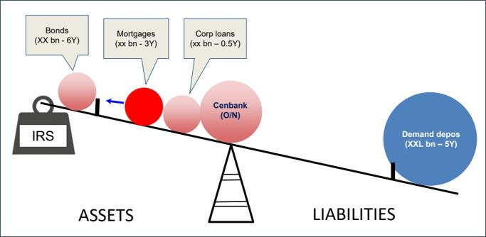
IRRBB arises because…
Banks are exposed to IRRBB primarily (but not wholly) due to the following:
Writing fixed-rate assets funded by floating-rate liabilities
Writing floating-rate assets funded by floating-rate liabilities referencing another index
To lengthen the funding profile of the bank, term funding is raised across the curve at fixed-term deposit rates that reprice only on maturity
Three-month repricing swaps and forward rate agreements are typically used in the risk management of term deposits and fixed-rate advances (now moving to overnight IRS)
Short-term demand funding products reprice to different short-end base rates
Certain non-repricing transactional deposit accounts are non-rate-sensitive
The bank has a mismatch in net non-rate-sensitive balances, including shareholders' funds that do not reprice for interest rate changes
Banking Book activities (lending and taking deposits) cause ‘structural’ risk. Mismatches arise from the structure of the deals that customers want.

Slide 88
How Significant is Structural Interest Rate Risk for Banks?
It is rarely, if ever, likely to cause existential risk exposure but that doesn’t mean that structural interest rate risk doesn’t matter to banks
Yield curve/gap, basis and option (pipeline and prepayment) risks can all have a material adverse effect on profitability, and if well managed, represent a source of competitive advantage
Many banks suffered in the aftermath of the financial crisis due to mismatches between Assets and Liabilities re-pricing off Base Rate and LIBOR

Slide 89
Interest Rate Risk in the Banking Book
Income View
Economic View
Accounting View
Δ NII
???
Δ NPV
Interest Accrual measured to point in the future
Short-/mid term view (e.g. 1 year)
Use of behavioural maturity assumptions (e.g. demand deposits)
(Net Present) Value discounted to today
All cashflows over the lifetime
Use of behavioural maturity assumptions
Loans and deposits are accrual accounted
Derivatives are marked to market
Bonds portfolio (e.g. HtM, FVOCI)
Use of contractual maturity (demand deposit)
Hedge accounting rules
Notes:
Pre financial crisis 1st line: Treasury owns Planning, Execution and Monitoring
worked in both models (model A at previous employer and now at CS migrating to Model Type B), chaired industry working group, spoke to risk manager who operate in Model Type A, discussed model type with FINMA, FED and PRA

Slide 90
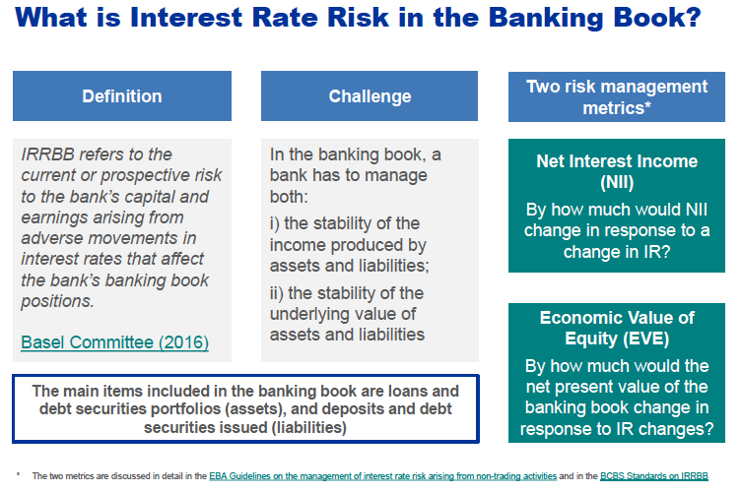
Interest Rate Risk in the Banking Book metrics
Items in scope, definition, challenges and metrics.
1
2
3
4
2
3
4
1
Source: ECB, 2017

Slide 91
Steps to Calculating NII Sensitivity
Step 1 – Project all notional re-pricing cash flows arising from current balance sheet interest rate sensitive assets, liabilities and off-balance sheet instruments for the next 12 months.
Assume BAU projected balance sheet growth over next 12 months and slot the interest income and interest expense from this assumed future business into the relevant bucket for next 12 months
A notional re-pricing cash flow is any repayment of principal, any re-pricing of principal or any interest payment on a tranche of principal that has not yet been repaid or re-priced, arising from the current balance sheet position and expected future balance sheet items in next 12 months
Step 2 – Slot the Cash flows into the month in which they occur, and sum the net interest income (NII). This is the baseline NII
Step 3 – Apply the yield curve shock, which will impact all floating-rate cashflows, to determine the new NII value. Make and apply assumptions on (i) time lag and magnitude of interest rate changes feeding through to customer products (ii) behavioural assumptions regards impact on volume notionals (eg., prepayment of floating rate loans)
Step 4 – The NII sensitivity is the difference between the Baseline NII and Shock Scenario NII.

Slide 92
Interest Rate Risk in the Banking Book
Delta Net Interest Income
1
Introduction
2
Measuring IRRBB
3
Case studies
Example: Impact of instantaneous parallel upward move in rates by 50 bps for the next coming year?
TIME BUCKET | AVERAGE TERM | RESIDUAL TERM IN YEARS | GAP (BN) | EFFECT IN NET INTEREST INCOME (MIO)
Sight | 0 | 1 | -100 | -100 x 1 x 0.50% = -500
Sight – 1 month | 0.5 months | 0.96 (=11.5/12) | -10 | -10 x 0.96 x 0.50% = -48
1 – 2 months | 1.5 months | 0.88 (=10.5/12) | -5 | -5 x 0.88 x 0.50% = -22
2 – 3 months | 2.5 months | 0.79 | 20 | 20 x 0.79 x 0.50% = 79
3 – 4 months | 3.5 months | 0.71 | 15 | 15 x 0.71 x 0.50% = 53.25
4 – 5 months | 4.5 months | 0.63 | -12 | -12 x 0.63 x 0.50% = -37.8
5 – 6 months | 5.5 months | 0.54 | 10 | 10 x 0.54 x 0.50% = 27
6 – 7 months | 6.5 months | 0.46 | 14 | 14 x 0.46 x 0.50% = 32.2
7 – 8 months | 7.5 months | 0.38 | -7 | -7 x 0.38 x 0.50% = -13.3
8 – 9 months | 8.5 months | 0.29 | -4 | -4 x 0.29 x 0.50% = -5.8
9 – 10 months | 9.5 months | 0.21 | 3 | 3 x 0.21 x 0.50% = 3.15
10 – 11 months | 10.5 months | 0.12 | -2 | -2 x 0.12 x 0.50% = -1.2
11 – 12 months | 11.5 months | 0.04 | 2 | 2 x 0.04 x 0.50% = 0.4
 |  |  |  | -433.1
Source: L.v.d. Wielen, 2016, p.109

Slide 93
Interest Rate Risk in the Banking Book
Economic Value of Equity (EVE)
EVE defined as difference between the present value of assets and liabilities (and off balance sheet exposures).
Assets
Liabilities
Σ present value of assets (includes unrealised gains)
Σ present value of liabilities
Equity (Surplus)
Σ present value off balance sheet
Source: based on Lukas, Witte, Universität Kassel, 2008
Notes:
Asset Liability Management = Management of assets and liabilities under consideration of alternative rates, liquidit and client behaviours with the objective to optimise the overall position with regard to the risk return profile.
Welche Folgen wären bei unterschiedlich langen Laufzeiten zwischen den Bilanzseiten denkbar (Stw. Risiko)?
Eine geeignete Bewertung der „Bilanz“ muss helfen, das Zinsänderungsrisiko aggregiert auf Gesamtbankebene zu ermitteln.
Die zunächst trivial anmutende Aufgabe erweist sich in der Praxis als durchaus anspruchsvoll, da unterschiedliche Finanzprodukte isoliert bewertet und anschließend korrekt zusammengefasst werden müssen.
In einer Art Inventur muss die gesamte Bilanz und das ausserbilanzielle Geschäft derart
aufgelistet sein, dass unmittelbar die Zinsposition erkennbar ist

Slide 94
Steps to Calculating EVE Sensitivity
Step 1 – Project all notional re-pricing cash flows arising from current balance sheet interest rate sensitive assets, liabilities and off-balance sheet instruments. Note, BCBS suggest excluding fixed assets, equity exposures in the banking book and capital
A notional re-pricing cash flow is any repayment of principal, any re-pricing of principal or any interest payment on a tranche of principal that has not yet been repaid or re-priced, arising from the current balance sheet position
Note that EVE measure requires:
-- Static balance sheet, no future business assumptions
-- Positive changes to EVE Delta from rate moves are to be weighted by 50%
Step 2 – Slot the Cash flows into the re-pricing maturity gap schedule time buckets
Step 3 – Net the notional re-pricing cash flows in each time bucket and weight them by a continuously compounded discount factor (representing the existing level of interest rates). Sum the weighted net positions to determine the EVE
Step 4 – Repeat the process for each interest rate shock scenario. Compare the results to the base case to establish EVE sensitivity

Slide 95

Illustrative Maturity Schedule Time Buckets for EVE Calculation
Discount factors based upon 3% interest rates at all tenors
When a shock is applied to the level of interest rates, the discount factors change and, if interest rate risk is present, will result in a movement in the calculated EVE
Discount factors based upon 5% interest rates at all tenors
The general (typical) position is for a bank’s balance sheet to show a decline in EVE for a rise in interest rates
This reflects time value of money (discounting) principles and the fact that banks fixed-rate assets are longer dated than their fixed rate liabilities

Slide 96
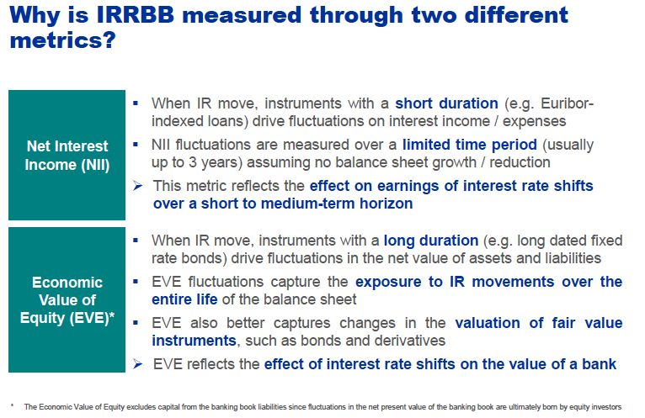
Why is IRRBB measured through two different metrics?
Interest rate shifts have effect on the earnings as well as the value of a bank.
next 12 months assuming BAU
Source: ECB, 2017

Slide 97
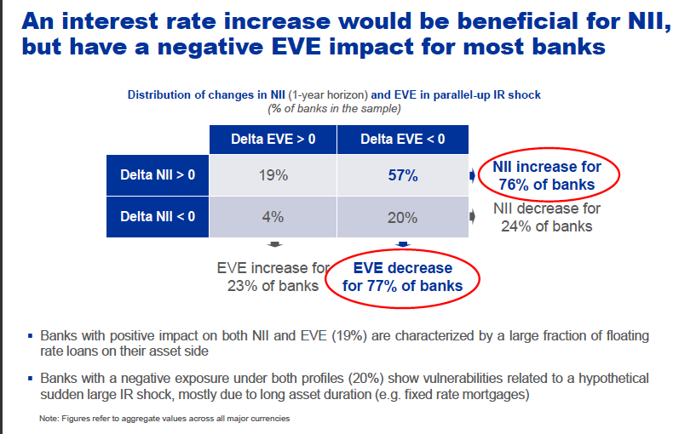
A generalized risk position of most banks…..!
ECB 2017: “An interest rate increase would be beneficial for NII but have a negative EVE impact for most banks.”
Source: ECB, 2017

